Slide 1
Waterwise Landscaping

Slide 2
Purpose of Landscaping
Beauty
Utility
Conservation
Notes:
With water becoming a limited resource, conservation has become a third purpose of landscaping.

Slide 3
Waterwise Options
Zeroscaping
Xeriscaping
Wildfire Aware Options
Defensible landscaping
Zoning

Slide 4
Zeroscaping
Low to No Maintenance Landscaping Design

Slide 5
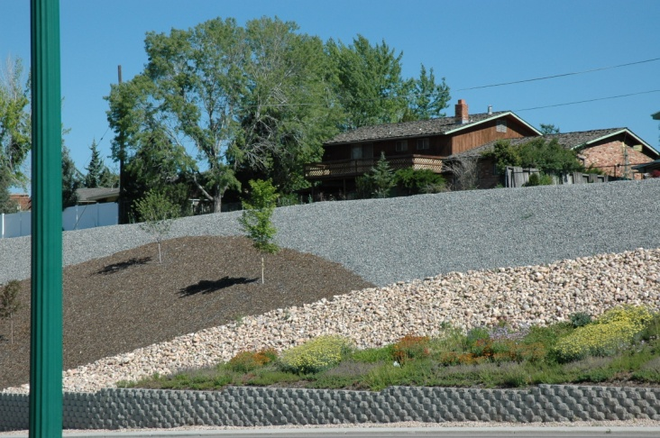
Characteristics
Uses a variety of rocks for design
Sparse use of drought-resistant plants
Relies on rainwater or limited watering

Slide 6
Benefits
Conserves water
Saves $$$
Low maintenance
Presents minimal pest and disease problems
Saves landfill space

Slide 7
Disadvantages
Scarcity of plant life
Possibility of unattractive aesthetic quality

Slide 8
Xeriscaping
Water –Conservative Approach to Landscaping
Notes:
Xeriscaping is created by the combination of the Greek word Xeros (dry) with landscaping. Term coined by the Front Range Xeriscape Task Force of the Denver Water Department in 1981.

Slide 9
Characteristics
Uses a variety of rocks to enhance design
Uses multiple drought-tolerant plants
Can be very colorful
Relies on rainwater or limited watering

Slide 10
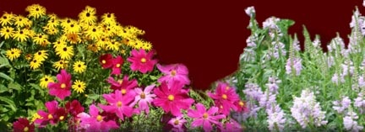
Benefits
Conserves water
Provides attractive planning options
Presents minimal pest and disease problems
Requires low pruning and maintenance
Saves landfill space

Slide 11
Disadvantages
Initial cost may be high
Initial cost offset by future savings

Slide 12
Principles for Waterwise Landscaping
Tips from the Office of Community Services, Fort Lewis College
1
Develop Landscape Plan
2
Condition Your Soil
3
Limit Lawn Size
4
5
6
7
Irrigate Efficiently
Use Appropriate Plants
Maintain
Apply Mulches

Slide 13
Resources
Office of Community Services Fort Lewis College (http://ocs.fortlewis.edu/waterwise)
XericUtah Landscape Design (http://xericutah.com)

